Slide 1


Week 1
QSRs
Smart POS Exception Reporting
VMS & Business Insights
Drive-thru
Week 2
Retail
Smart POS Exception Reporting
VMS & Business Insights
+
Training
Series
Week 3
Grocery & C Store
Smart POS Exception Reporting
VMS & Business Insights
EVT
Week 4
Carwash
Incident Reporting & Cloud Storage
POS Reporting & VMS
Business Insights

Slide 2

Smart POS Exception Reporting for QSRs
Driving Profitability

Slide 3
Business Drivers
High Level Solutions, Architecture & Use Cases
Exception Based Reporting Demo
Case Studies
Competition
Sales Summary: Buyers & Pitch
FAQs
+
Training
Agenda

Slide 4



Business Drivers for QSR Segment
Revenue
Labor
Food and Paper cost

Slide 5
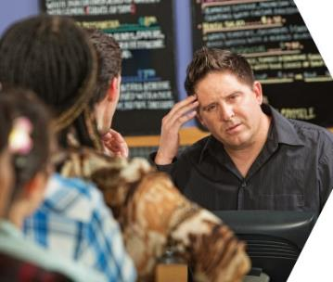
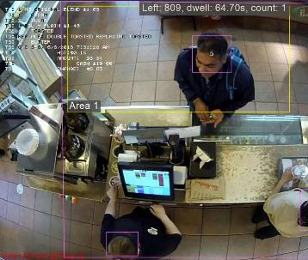
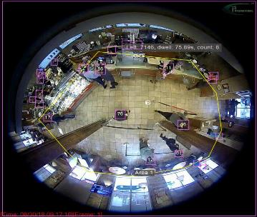
Sales Drivers for POS Exception Reporting
Need to control and eliminate internal theft
Labor shortages lead to more demand on the manager’s time
Need to change POS platforms - Tougher PCI/PII Compliance needs are forcing some operators to change platforms
Adding new locations or expanding or remodeling store
Contract expiration on current vendor- cost cutting opportunity
Technology upgrade needs - standardization across stores, data silos or integration needs for POS data and video feeds
Fiscal year end - tax benefits and budget overflow for tech spend
Need to identify training opportunities for cash handling and customer service
“QSRs can lose up to 7% of sales to employee theft.”
-National Restaurant Association

Slide 6
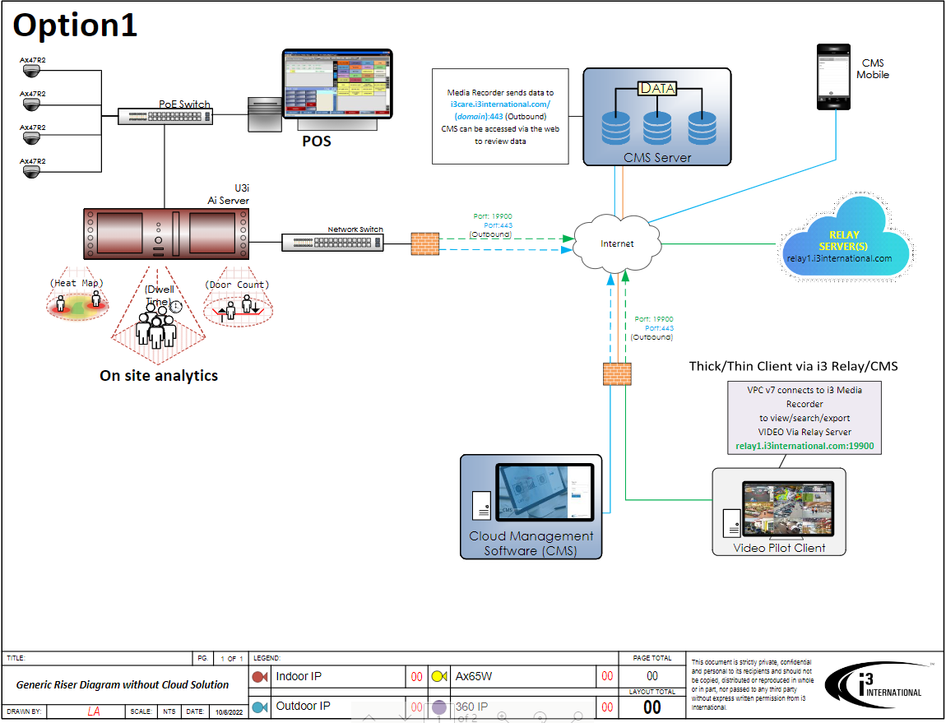

High Level Solution Diagram - Onsite POS integration

Slide 7
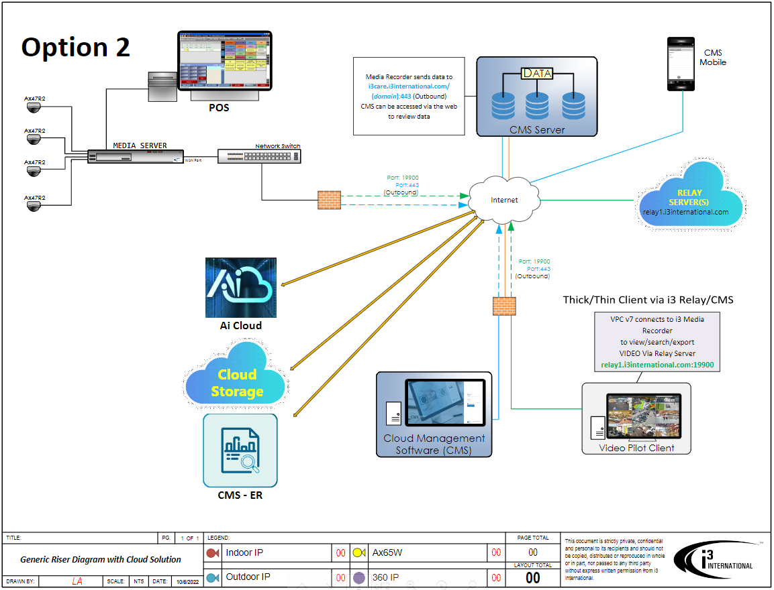
High Level Solution Diagram - Cloud POS integration

Slide 8


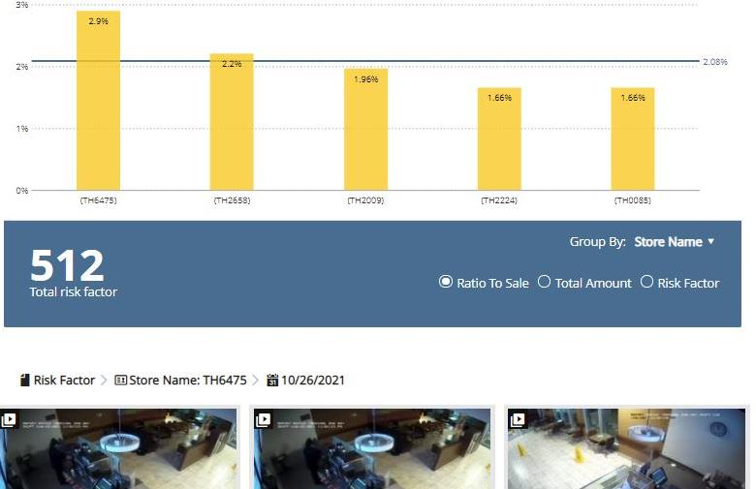
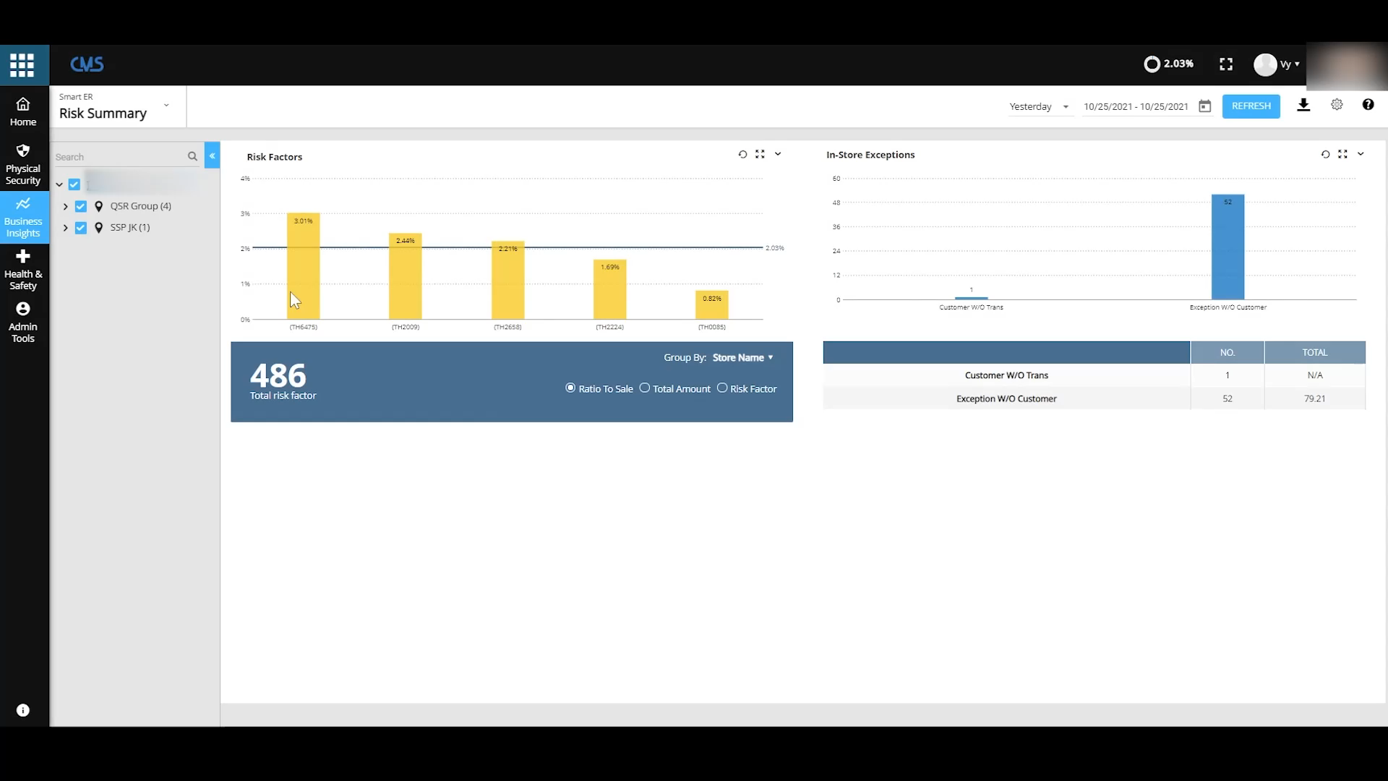
Combine video and POS to :
Uncover internal theft, fraud, voided transactions, and self-service kiosk fraud
Track sales performance across locations mapped to critical KPIs
Identify employee training opportunities and operational gaps
Notes:
Benefit of i3's smart video solution

Slide 9

Stop cash theft
i3’s patented video analytics engine with integrated POS data can stop cash theft & sweet-hearting at the drive thru and the front cash register.
Notes:
Benefit of i3's smart video solution

Slide 10
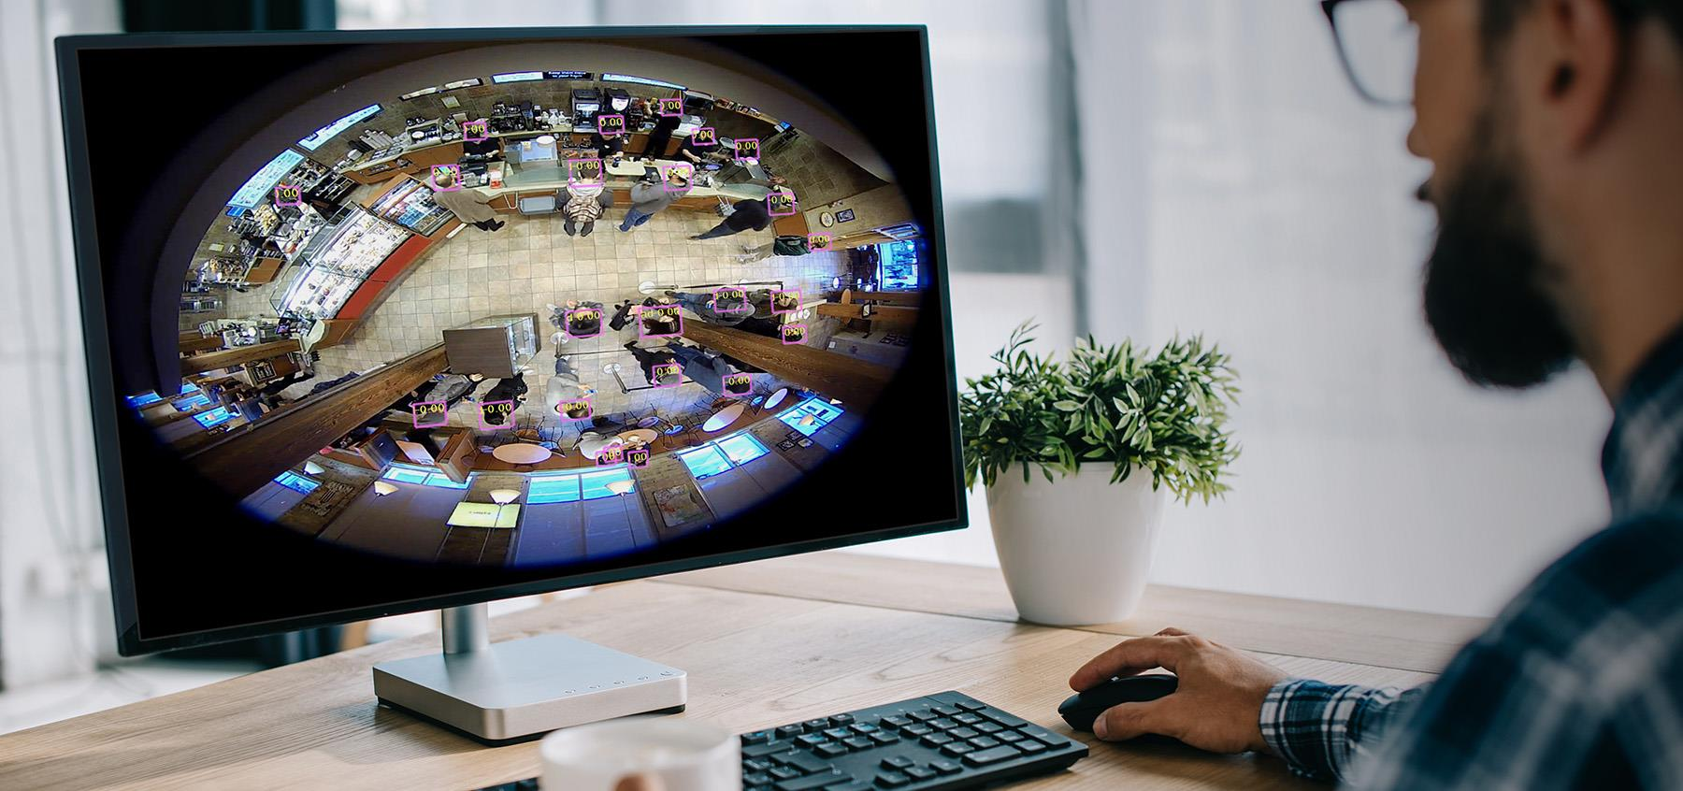
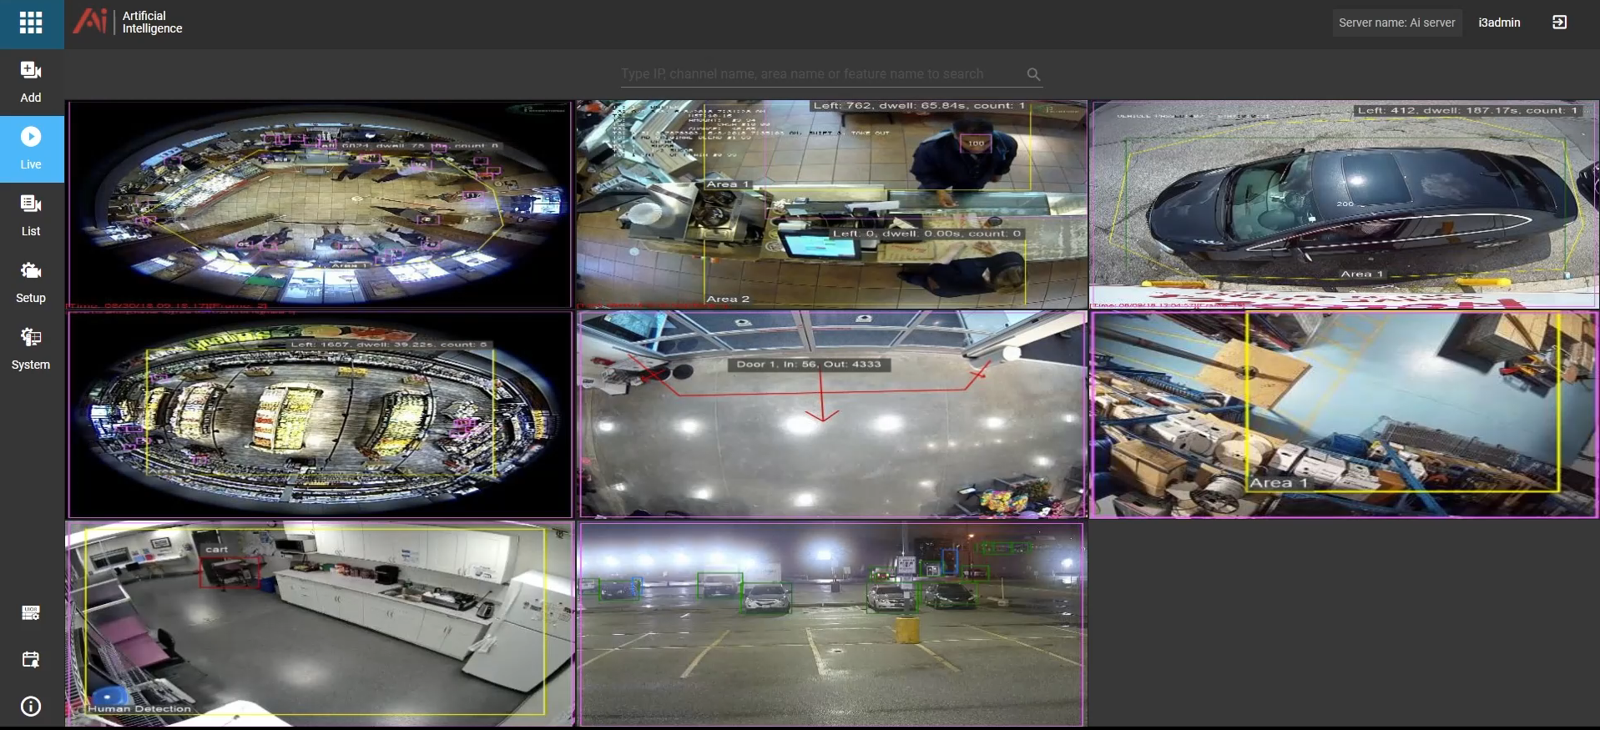
Demo: How Ai-based POS Exception reporting can benefit the QSR operator
Platform Demo Video
Notes:
Benefit of i3's smart video solution

Slide 11



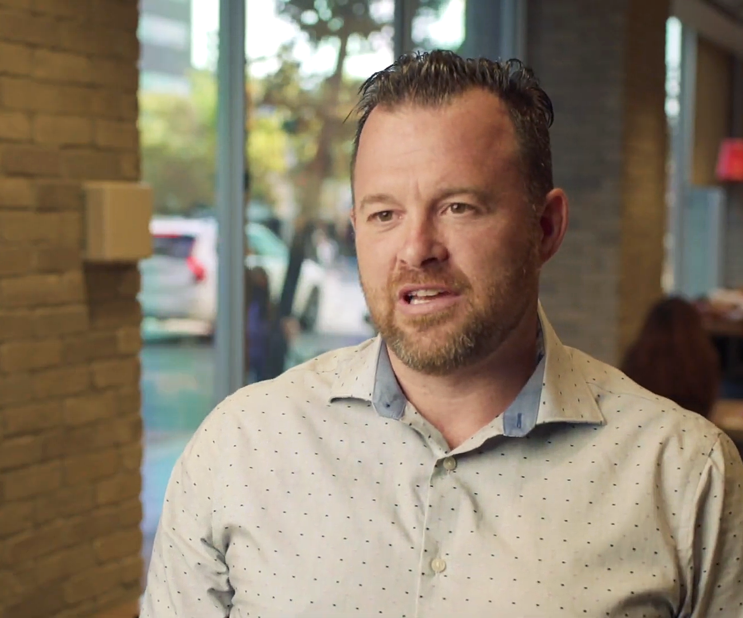


Case Study
2900 locations currently serviced in North America with 600+ connected to the cloud.
POS Exception Reporting Solution
10-24 cameras per location
Remote connection through the web and mobile
Challenges
Customer Quote /Benefits
Multiple POS system with various cameras types and formats
Reduced viewing video from multiple hours to 7-10 minutes per day with Smart-ER.
Small franchisee group with store count of 2-50 stores. No LP specific members to manage shrink
“Integrating my security system and Ai cameras with my POS system allows me to
be able to analyze traffic patterns, transaction times & transactions counts. It has given me a better understanding of what my throughput at different points of the day. It allows me to analyze how my staff are doing, and how quickly we are turning over each transactions. This real-time actionable data is a game changer for our business.”
- Jason St. Croix, Franchisee owner, Tim Hortons
Wanted to integrate camera system with POS data and have a solution that will comply with IT policies
Needed simple but powerful integrated system to reduce theft and improve the operation.

Slide 12
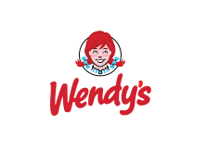
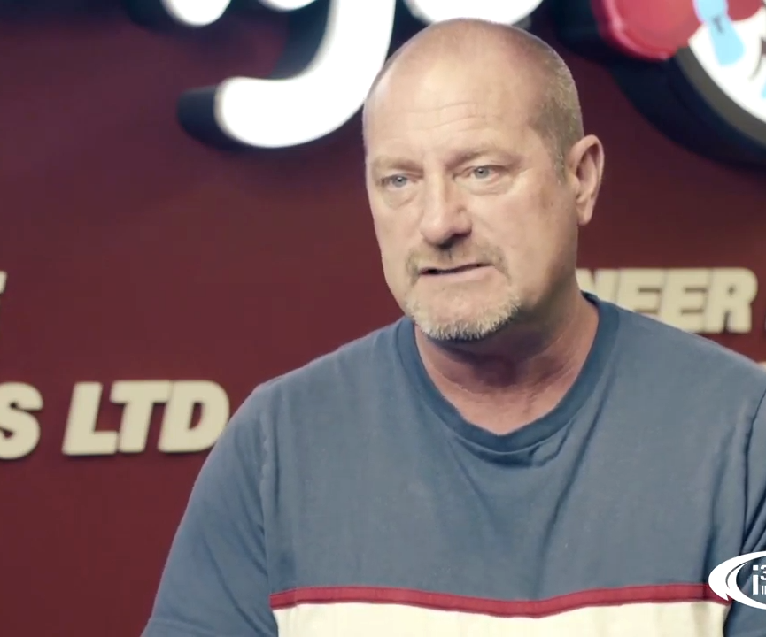
Case Study
6000 locations in North America -
Currently servicing 350 sites through multiple franchisee groups.
POS Exception Reporting Solutions
10-24 cameras per location
Remote connection through the web and mobile
Concierge level 1 support
Challenges
IT and POS feeds were controlled by 2 different vendors thus making POS integration very difficult
3rd party IT support was very restrictive with port opening and forwarding
Customer Quote /Benefits
“The i3 system has allowed us to run a more secure and safe restaurant. This organization is amazing to work with and I would highly recommend the i3 solution to any restaurant leader.”
− John Ribson,
Owner/Operator at Wendy’s
Wanted to integrate camera system with POS data
Needed simple but powerful integrated system to reduce theft and improve the operation.

Slide 13
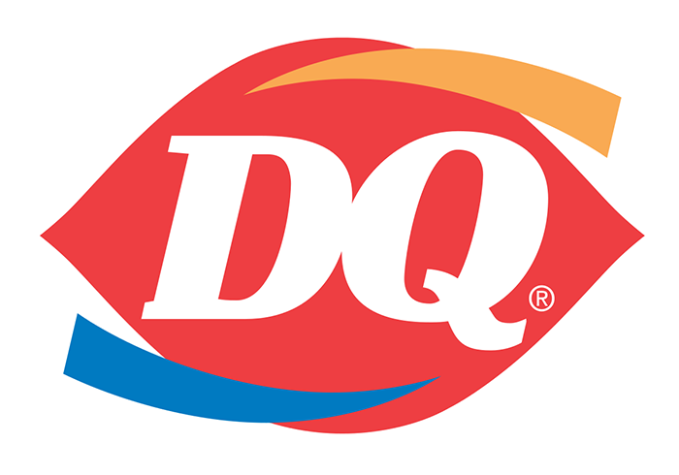
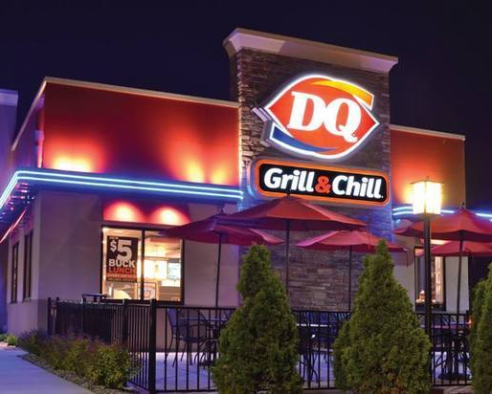
Case Study
DQ is very price sensitive because they are often seasonal, thus generating less revenue than most QSRs.
POS Exception Reporting Solutions
6-12 cameras per location
Remote connection through the web and mobile
Concierge level 1 support
Extended Cloud storage
Challenges
NO Integration of POS with
video systems
Customer Quote /Benefits
Seasonal operation that has a difficult time of tracking key inventory. No LP specific members.
“The integration of POS and video allows for relevant information, presented effortlessly in one location. Powerful video analytics, allow me to focus on other tasks versus investigating suspicious activities. I am able to quickly find what may have been missed via human limitations.”
− Andrew Colbourne,
Franchisee owner, DQ
Wanted to integrate camera system with Cloud POS data and in-store analytics.
Needed simple but powerful integrated system to reduce theft and improve the operation.

Slide 14



Competitive Landscape for POS Exception Reporting
Strengths | Weaknesses | Opportunities
Easy to use Good mobile interface Multiple POS integrations Constantly being updated with new add on services Email notifications- Daily, weekly, monthly 24/7 support Maintain SOC-2 Compliance | Can not view video and exception directly from the box at the site No ability currently to detect customer without transaction or vehicle without transaction | Contracts are very light so switching to another platform will be easier. Push for Ai and an operational tool not just POS integration
Recognizable brand Easy remote viewing Customized daily reports Push notification | Recently purchased by Motorola and development will diminish POS integrations lacks any unique technology Limited integration to POS vendors | Many Envysion customer will be open to discussing other opportunities that can achieve better results. Envysion will have some challenges with their contract renewals because Motorola will push for these to be renewed at full value or greater..
Manual audit reports (onsite and or Video Based) Push Notifications Strong contractual commitment Lifetime warranty & support (Life of contract) Cloud Based Analytics (?) | Higher monthly cost due to manual audits Video application is weak and playback is slow so POS audits may take longer No Ai or trying to establish an Ai engine to integrate to POS | DTiQ sells direct to the QSR segment . The do large POC test which makes it risky for other solution provider to follow. There test is strongly gear toward LP and shrink since they have can do the manuel audit. Talk about Ai and a full operational tool and be ready to prove a better ROI to win.

Slide 15


Initial Pitch
“Hi (first name of potential customer) ….My name is XYZ and our company has been working with many “QSR-name drop” like Wendy’s, Tim Hortons, Bojangles, BK, Popeye to help them reduce their loss at the POS to the tune of about 10-15 percent with the existing security infrastructure. Would you have some time to set up a meeting with a subject matter expert to share some of that info with you?”
Typical Decision Makers
Operation, IT, Finance Heads of AP/LP, or Risk Management
Franchise Owner, DM, Operation manager
Sales Tips
Get the decision maker involved early
Ask pointed Discovery questions besides BANT:
  Does your video currently integrate with your POS?
  How do you easily determine internal theft or loss at the POS?
Tailor proposal with their needs with minimal options
Understand their costs and provide ROI
Ask for referrals
Typical Influencers
District Manager or General manager
Ops/facility manager
Franchise Board, Investor Groups or Advisory Groups
Consultants and Secondary Vendors (POS companies)
Industry groups/sites: RLPSA, LPM, QSR magazine

Slide 16
Top Referenceable QSR Customers To Name Drop With Prospects
Customer | Solution Highlights | Locations on CMS
Tim Hortons - RBI | Integrated platform with POS, Ai and Business Intelligence | 600+
Popeyes - RBI | Integrated platform with POS, Ai and Business Intelligence | 150+
Burger King - RBI | Integrated platform with POS and Ai | 250+
Little Caesar | Integrated platform with POS and Ai and Business Intelligence | 105+
Kahala Brands | Integrated platform with POS and Ai, Business Intelligence and Velocity timer | 200+
KFC | Integrated platform with POS and Ai | 146+
Wendy’s | Integrated platform with POS and Ai | 250+

Slide 17
POS Exception Reporting - FAQs
What types of cameras are supported ?
What are the key stages in a POS implementation project?
What is the duration of a typical project ?
Will we support a POC? Maximum length?
What POS systems have we integrated successfully with?
How is the pricing structured? How do I get pricing for a prospect?
What is the handoff between Interface and i3 for training, install, support?

Slide 18

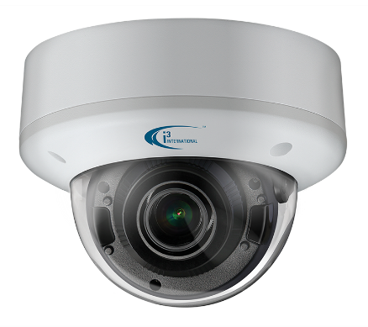
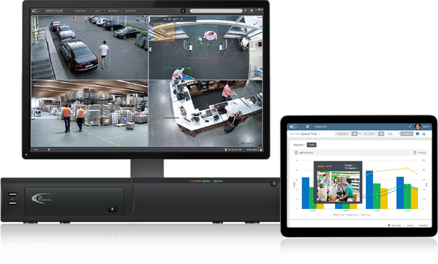
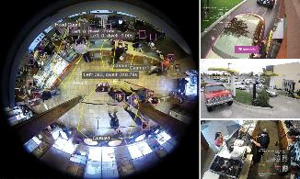


Full turn-key solution
Full turn-key solution including cameras switches, POS, Ai, & cloud solutions, to reduce the total cost of ownership.
Interconnected platform that integrates to third-party devices such as the POS, drive-through system, and other restaurant equipment - this gives the operator new insights into customer behavior and store operations.
Integrated platform
Secure cloud connection
Integrated data in real time, across a secure cloud network, encouraging positive behavior from staff members to improve sales and maximize output.

Slide 19

Next Steps

