Slide 1
Week 1
QSR
Smart POS Exception Reporting
Business Insights
Drive-thru
Week 2
Retail
Cloud VMS & Extended Storage
Smart POS Exception Reporting
Business Insights
+
Training Series
Week 3
Grocery
Smart POS Exception Reporting + Integrated VMS
Business Insights & Encrypted Video Download
Week 4
C-Stores & Carwash
Incident Reporting & Cloud Storage POS Reporting & Business Insights

Slide 2
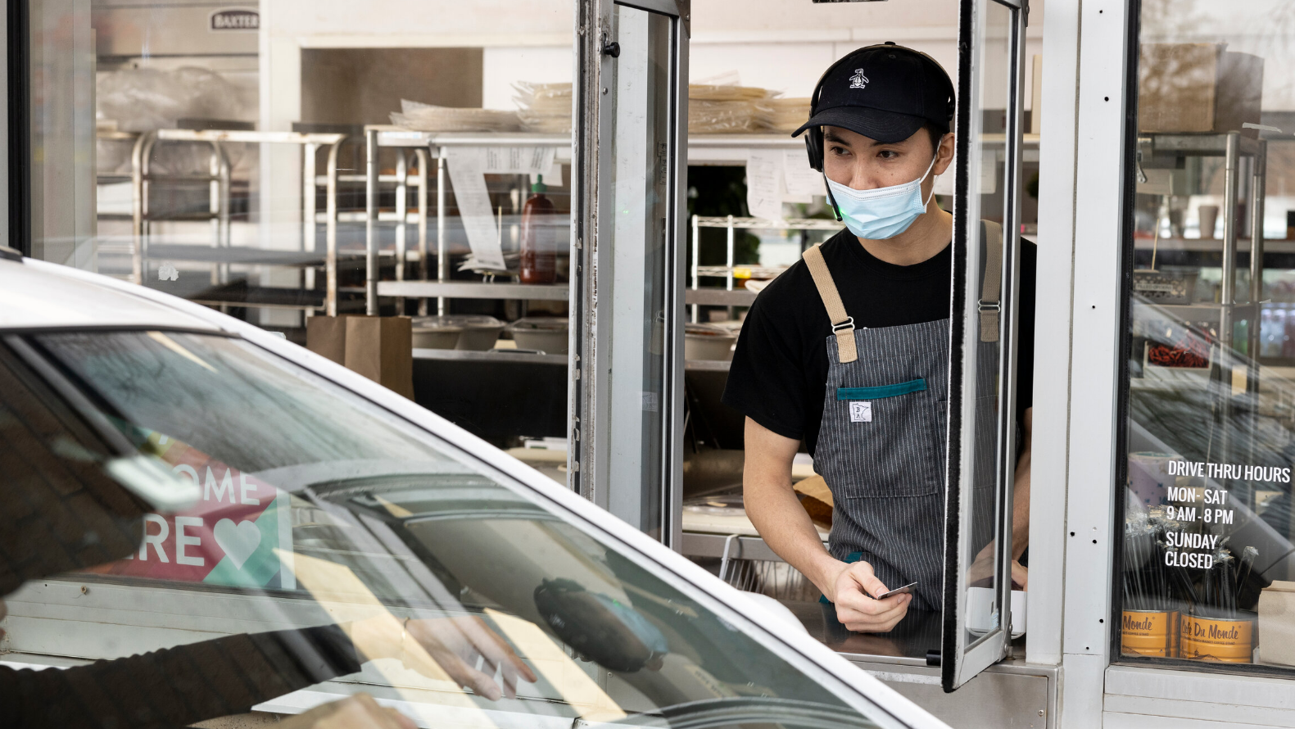
Drive- thru Insights for QSRs
Driving Profitability

Slide 3
Business Drivers
High Level Solution, Architecture & Use Cases
Drive-thru timer demo
Case Study
Competition & Cost Comparison
Sales Summary: Buyers & Pitch
FAQs
+
Training Agenda

Slide 4
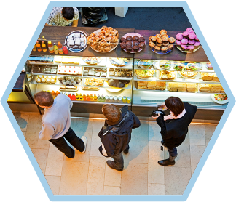
Business Drivers for QSR Segment
Revenue
Labor
Food and Paper cost

Slide 5
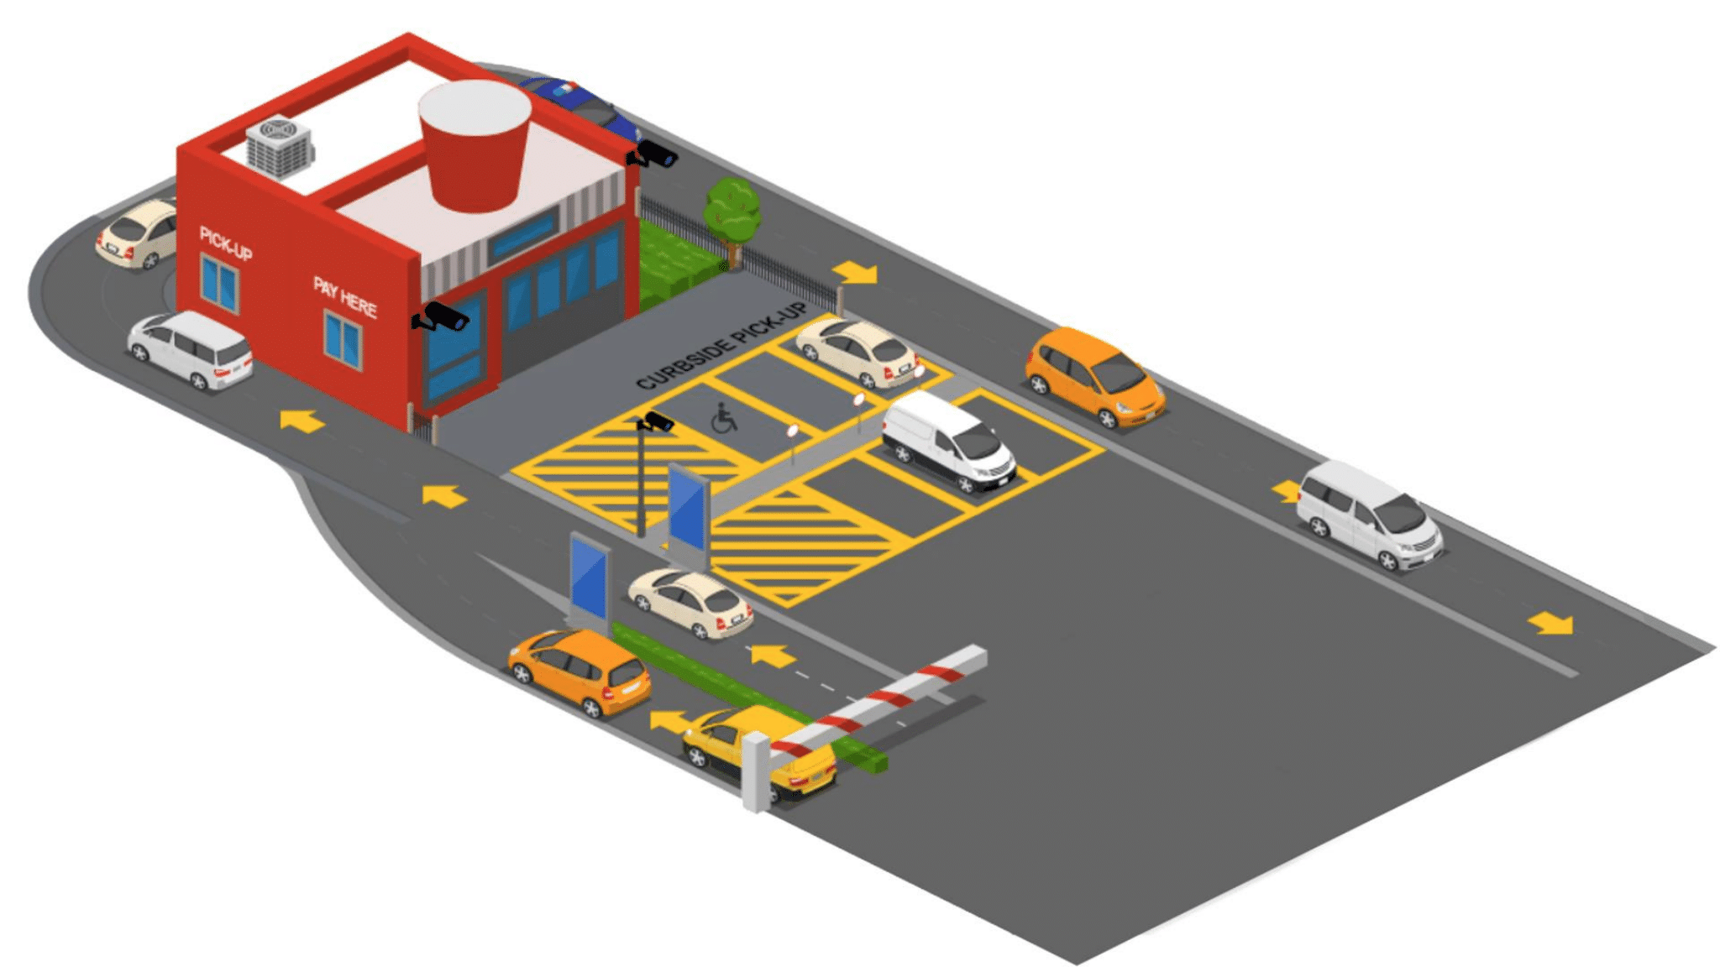

Slide 6
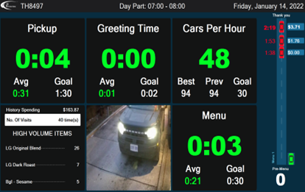
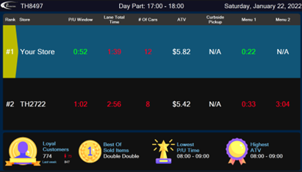
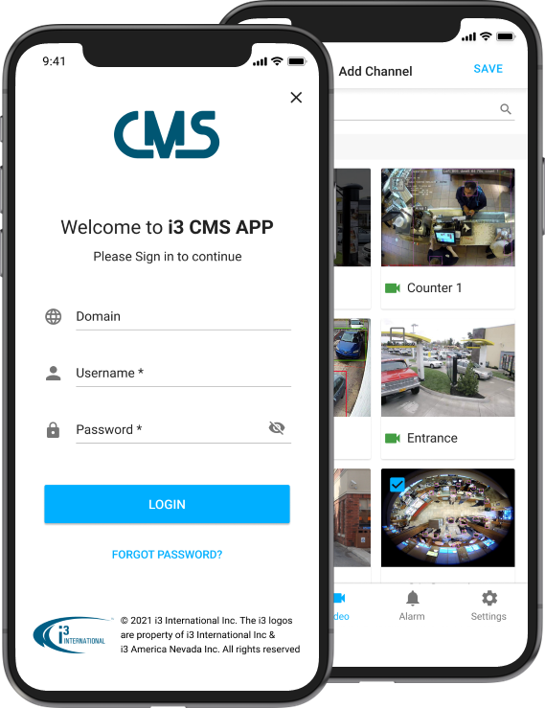
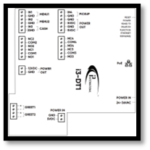
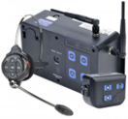
High Level Solution Diagram - Velocity Timer
IP speakers & PVM
Ground loop
Media Server
Velocity hardware
Wireless Headset
CMS
Customer
Notes:
Analytics on the media server - there is a powerful graphics card - Can analyze data real time on site but extra cost - real -time

Slide 7
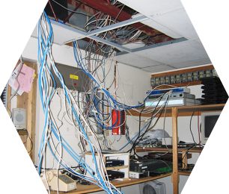
“HME is estimated to have +80% of the drive thru timer market for the QSR segment”
Business Drivers for Drive-Thru
Analog Platform
User Frustration
No Ai or machine learning
Inside service time
Cost savings
Drive-thru technology has not been improved for the past 20 years
Current drive-thru systems can not address new drive-thru concepts, be manipulated & is often not integrated to video or POS
Most drive-thru platform offers no Ai or machine learning to help operators gain deeper insight into their operation & customers
There are currently no cost-effective solutions to measure speed of service for the inside of the store or at curbside
There is a substantial opportunity to reduce cost for the operator while greatly enhancing drive-thru solutions

Slide 8
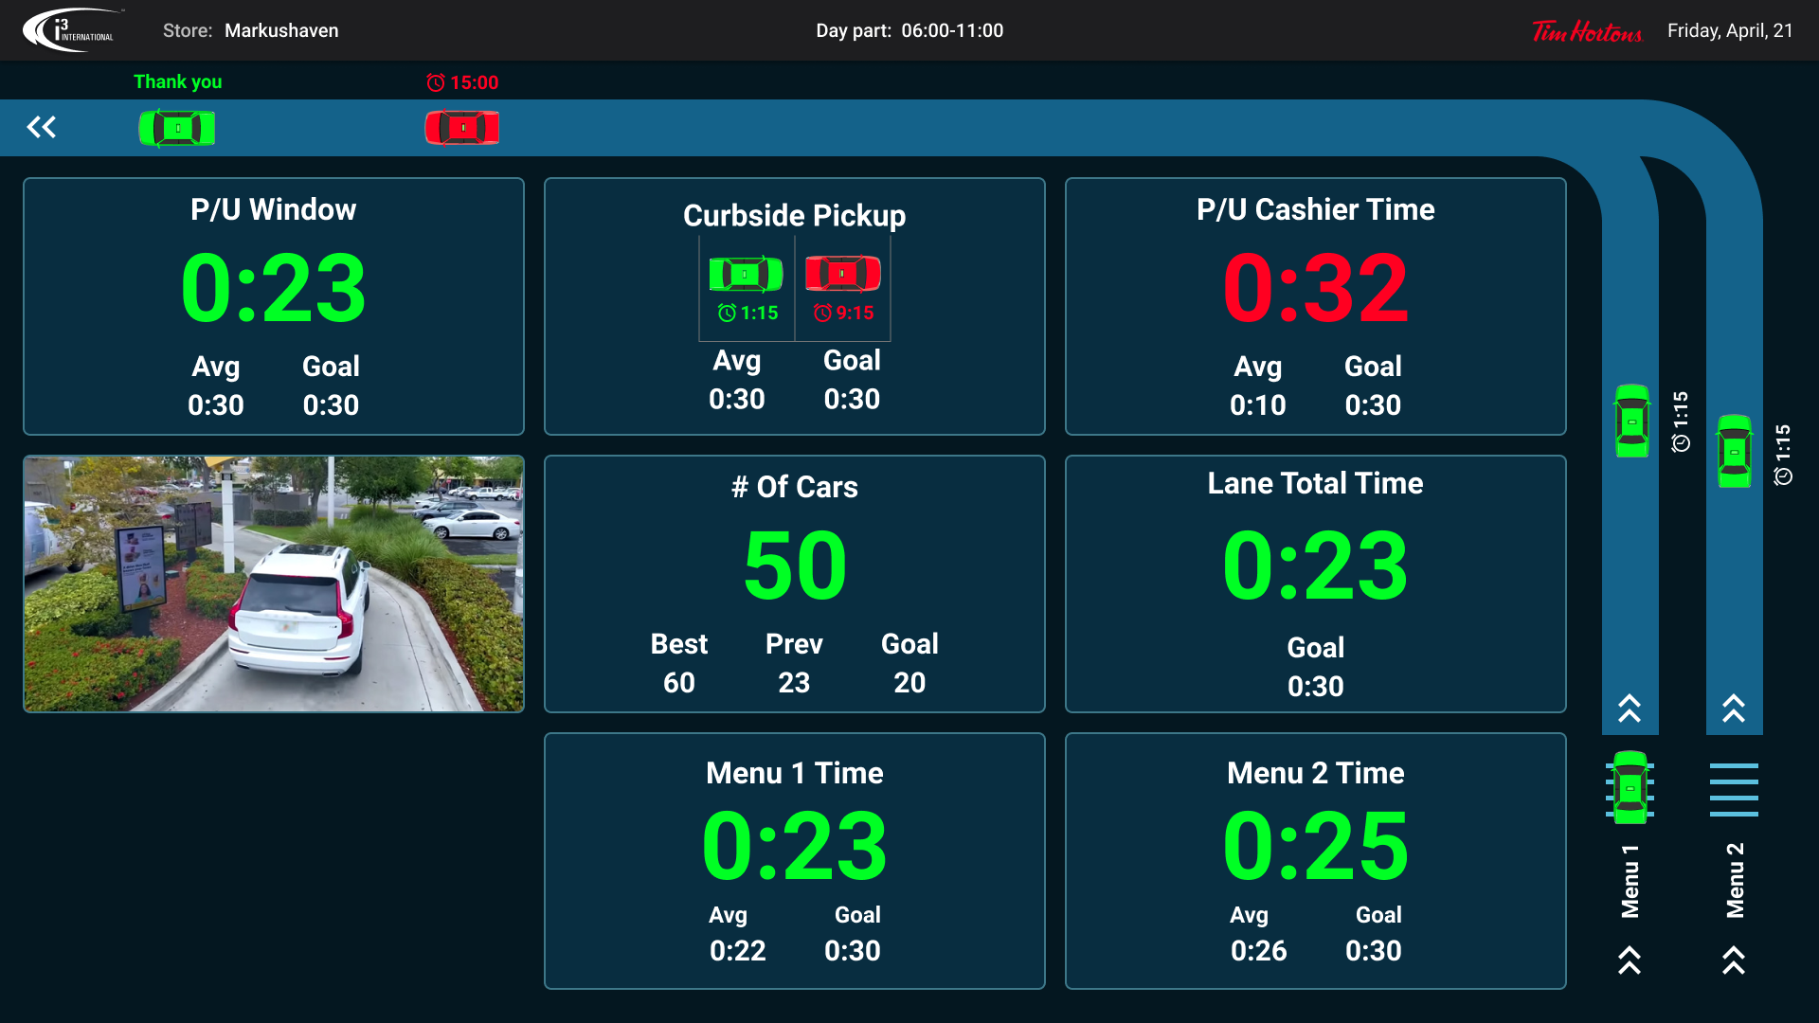
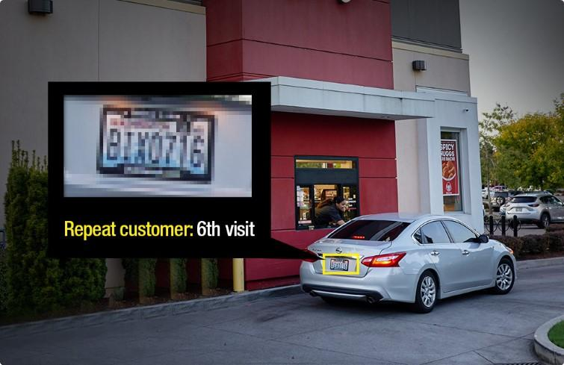
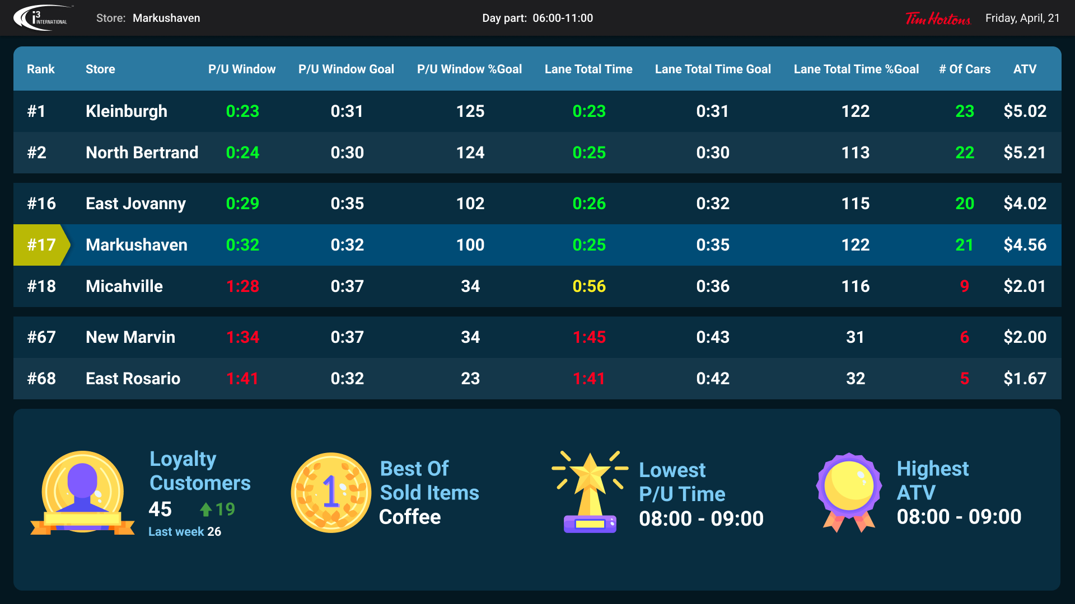
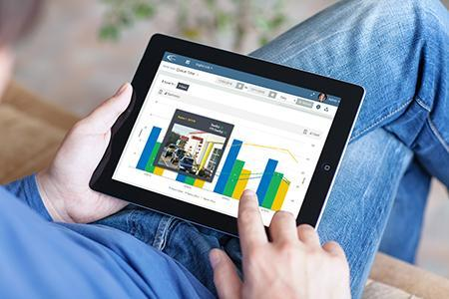
Velocity Timer
The Velocity drive-thru timer is the only timer that enables operators to dramatically improve their speed of service metrics at the drive-thru, curbside and front cash register.
Integrated platform
AI Engine
Leaderboard, gamification & upselling
Enhanced reporting tools
Most advanced drive-thru system that can be integrated into your video and POS system in real-time
i3’s Ai engine can help operators measure inside/outside speed of service and repeat customers
Supports real-time data output such as leader board, gamification & upselling to keep QSR staff engaged and motivated
i3’s integrated platform allows the operator to make informed decisions to help increase their revenue & store performance

Slide 9
Velocity Timer: complete speed of service in all areas of the store
Works with current site infrastructure (bolt on)
Tamper proof
Supports video playback
Supports POS integration
Supports Video AI
Supports License Plate Recognition (LPR) to track repeat customers
Remote access and diagnostics
Enterprise system management
Power reports on mobile devices
Platform Demo

Slide 10
Benefits
Price guarantee
Life-time warranty & updates
Online diagnostic
i3’s price match guarantee ensures that the most advanced drive thru timer is also the most affordable
Any Velocity timer connected to i3’s CMS with cloud video will have full coverage from manufacturer defects for the lifetime of the contract
i3 can help deliver real-time support to the operator and business through online diagnostics tools to ensure uptime

Slide 11
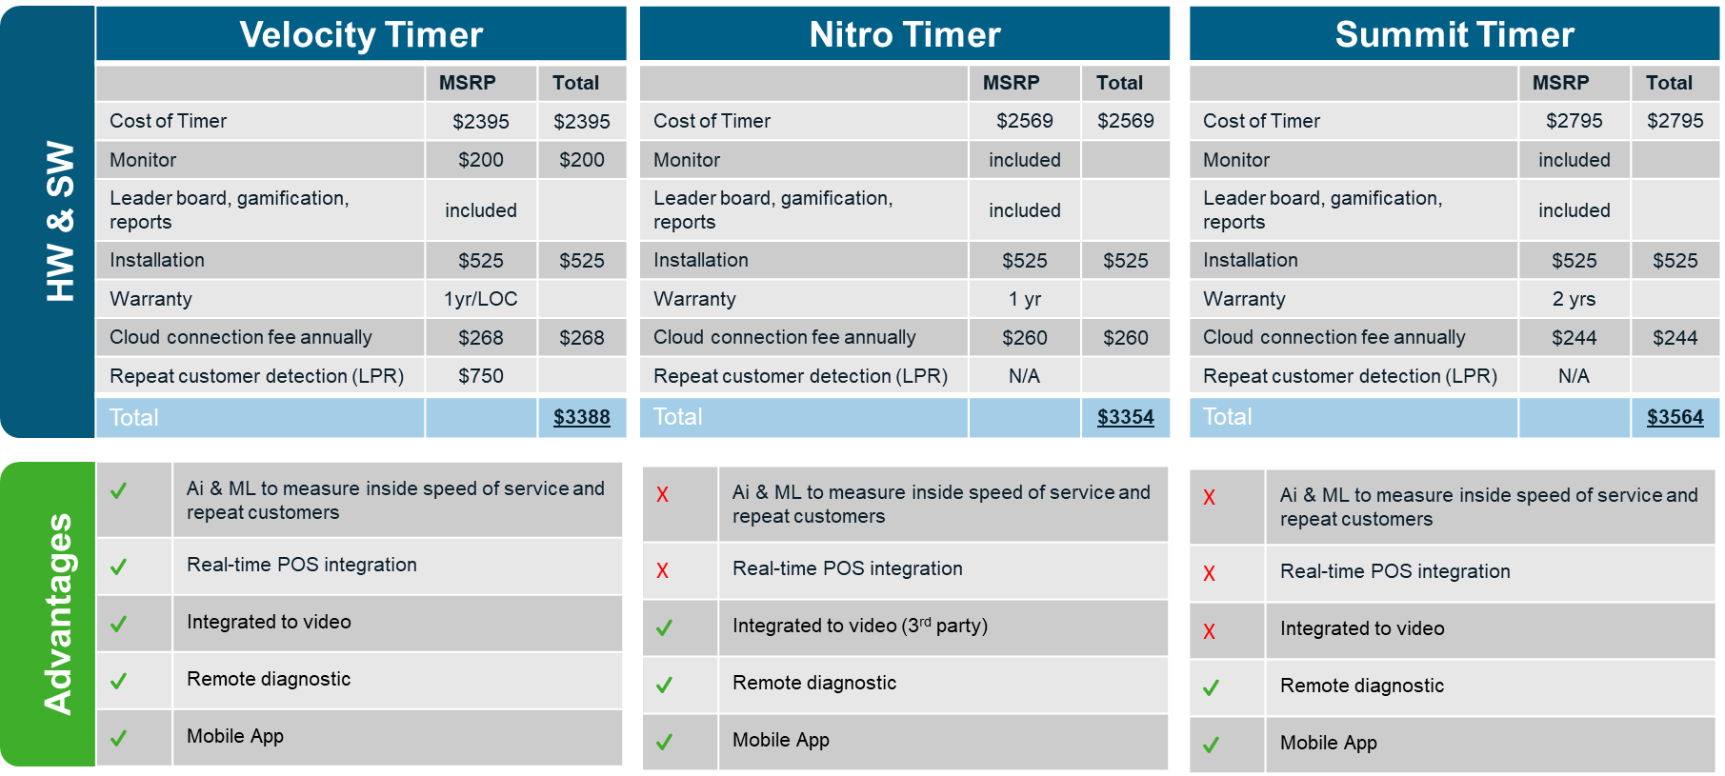
Competitive Cost Comparison

Slide 12
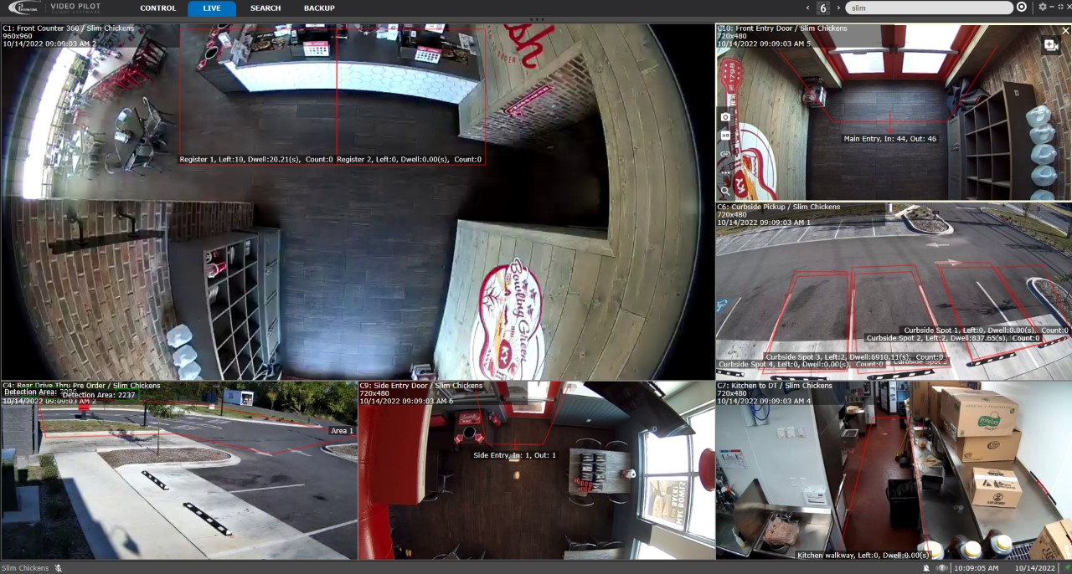
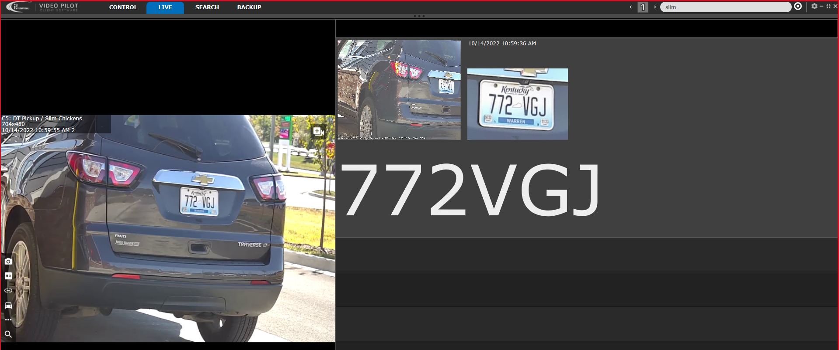
Complete QSR integration project!
Curbside
Front & back of house
Drive-thru
Repeat customer

Slide 13
Case Study
One of the busiest Hot Dog chains in North America
Velocity Timer Solution
Servicing 300-1000 cars a day
Y-lane with pick-up widow and pay-window
22 cameras with LPR and 360 technology
3 public view monitors: Drive-thru, Leaderboard, and Manager office
Full speed of service tracking outside, front-of-house and back of house
Challenges
Conventional drive-thru timer did not give the operator real time actionable data
Customer Quote /Benefits
Wanted to track speed of service throughout the store: drive-thru, curbside, in-store and online.
“Drive-thru technology has not changed in the 20 years that I have been working in the QSR segments. We can service as many as 1000 cars over the weekend and having a solution that can track our team members’ performance in this environment is critical. i3’s Velocity timer has given our very busy location new insights into how we can improve our speed-of-service. Not only does this timer measure our service time at the drive-thru but the Ai technology helps us understand customer traffic inside our store as well. This actionable data is sent to multiple monitors inside our restaurant to help our staff deliver better customer service.
My only wish is that I had this technology 20 years earlier.”
Wanted to integrate drive-thru with Ai, camera system, LPR and POS data to allow managers and staff to provide consistent service.
Greg Vojnovic
Chief Executive Officer Hot Dog Shoppe
Needed an integrated system that would help them get a edge on the competition.

Slide 14
Initial Pitch
“Hi (first name of potential customer) ….My name is XYZ and our company has been working with many “QSR-name drop” like Wendy’s, Tim Hortons, Bojangles, BK, Popeye to help reduce service time at the drive-thru and in-store utilizing video analytics. This technology can be bolted onto your existing HD cameras. Would you have some time to set up a meeting with a subject matter expert to share some of that info with you?”
Typical Decision Makers
COO, CTO, CIO, IT, Digital transformation Manager or Facility managers
Franchise Owner, DM, Operation manager
Sales Tips
Go after the smaller QSR brands or brands that have not standardized on a timer
Ask pointed Discovery questions besides BANT:
Does your drive-thru timer integrate with your POS?
Does your drive thru timer measure repeat customers?
Do you measure speed of service at your counter?
Leverage the drive thru timer to get additional video business
Ask for referrals
Typical Influencers
District Manager or General manager
Ops/facility manager
Franchise Board, Investor Groups or Advisory Groups
Large franchisee owner group
Consultants and Secondary Vendors (POS companies)
Industry groups/sites: QSR magazine, Murtec, RLC

Slide 15
Drive-Thru Timer - FAQs
Name four of the on-site components of a drive-thru timer solution?
What are the methods that speed of service can be tracked with an i3 solution?
Can I run the Velocity timer in parallel with any existing timers QSRs may have?
Who should you prospect for drive through timers?
What is the pricing model?
Will we support a POC? Maximum length?
Will QSRs have to make any significant construction changes to implement this timer?
Notes:
Ground loop, velocity idle relay hardware, media server, monitors, speakers, LPR cameras
Drive-thru timer, Cameras (POS Exception wrong choice)
Yes
Large Brands - RBI (NO), New and upcoming brands (yes) Casual dining (yes)
Hardware and cloud fee
Yes (between 90-120 days) /No
No

Slide 16
Why i3 for QSR
Bolt-on or take over
Strong commitment to the partnership
Integration with drive-thru timer
Complete turn key solution
Cloud Video & storage
Applicable Ai solutions
Powerful Smart exception reporting
Interface C3 Integration (Jan 2023)

